Slide 1

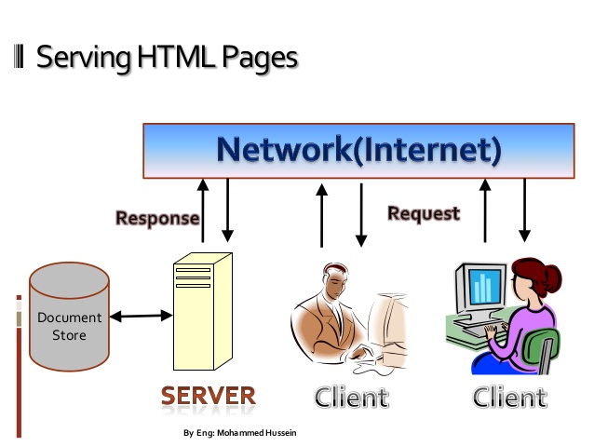
CS8651 INTERNET PROGRAMMING VI SEMESTER R2017

Slide 2
COURSE OUTCOMES (CO)
COURSE OBJECTIVES
1. To understand different Internet Technologies
2. To learn java-specific web services architecture
CO 1 | Students will be able to construct a basic website using HTML and Cascading Style Sheets.
CO 2 | Students will be able to build dynamic web page with validation using Java Script objects and by applying different event handling mechanisms.
CO 3 | Students will be able to develop server side programs using Servlets and JSP.
CO 4 | Students will be able to construct simple web pages in PHP and to represent data in XML format.
CO 5 | Students will be able to use AJAX and web services to develop interactive web applications

Slide 3
Course Delivery Plan
UNIT II CLIENT SIDE PROGRAMMING
Session # | Topic
1 | Web Essentials: Clients, Servers and Communication – The Internet – Basic Internet protocols – World wide web
2 | HTTP Request Message – HTTP Response Message – Web Clients – Web Servers.
3 | HTML5 – Tables
4 | Lists – Image
5 | HTML5 control elements – Semantic elements
6 | Drag and Drop – Audio – Video controls
7 | CSS3 – Inline, embedded and external style sheets
8 | Rule cascading – Inheritance – Backgrounds –Border Images – Colors - Shadows
9 | Text – Transformations – Transitions – Animations.

Slide 4
SESSION 1

Slide 5
Web Essentials
Clients, Servers and Communication
The Internet
Basic Internet protocols
World wide web
HTTP Request Message
HTTP Response Message
Web Clients
Web Servers.

Slide 6
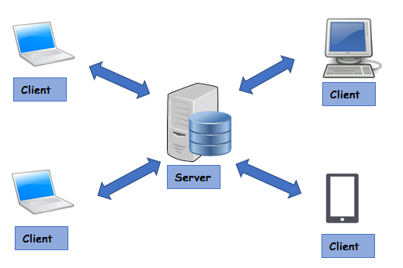
Clients, Servers and Communication
Client: A computer or smart phone or software programs used to connect remote device through network connection
Server: A computer or a device or software program used to serve client request

Slide 7
The Internet
Global system of interconnected computer networks that use the Internet protocol suite (TCP/IP) to link devices worldwide
Network of networks that consists of private, public, academic, business, and government networks of local to global scope, linked by a broad array of electronic, wireless, and optical networking technologies
Carries a vast range of information resources and services, such as the inter-linked hypertext documents and applications of the World Wide Web (WWW), electronic mail, telephony, and file sharing

Slide 8
Basic Internet Protocols
HTTP(Hyper Text Transfer Protocol)
DNS (Domain Name System)
FTP (File Transfer Protocol)
SMTP(Simple Mail Transfer Protocol)
TELENT
ARP (Address Resolution Protocol)
DHCP (Dynamic Host Configuration Protocol)
TCP(Transmission Control Protocol)
IP (Internet Protocol)

Slide 9
World Wide Web (Web)
1989 – Tim Berners-Lee
An Information System, where documents and other web resources are identified by URLs
Central, to the development of the Information Age
The primary tool, billions of people use to interact on the Internet.
With a web browser, a user views web pages that may contain text, images, and other multimedia contents and navigates between them using hyperlinks

Slide 10
Web Page
A Web page is a hypertext document formatted in Hypertext Markup Language (HTML)
It displays embedded hyperlinks with URLs, which permits users to navigate to other web resources
web pages may contain references to images, video, audio, and software components, which are either displayed or internally executed in the user's web browser to render pages or streams of multimedia content
Web pages are created with the following extensions:
.html
.jsp
.aspx
.asp
.php
Admin

Slide 11
Website
Multiple web resources with a common theme and usually a common domain name make up a website
Websites are stored in computers that are running a web server, which is a program that responds to requests made over the Internet from web browsers running on a user's computer

Slide 12
SESSION 2

Slide 13
HTTP
HTTP is a client-server protocol which allows the fetching of resources, such as HTML documents
It is the foundation of any data exchange on the Web
Clients and servers communicate by exchanging individual messages
The messages sent by the client, usually a Web browser, are called requests and the messages sent by the server as an answer are called responses.

Slide 14
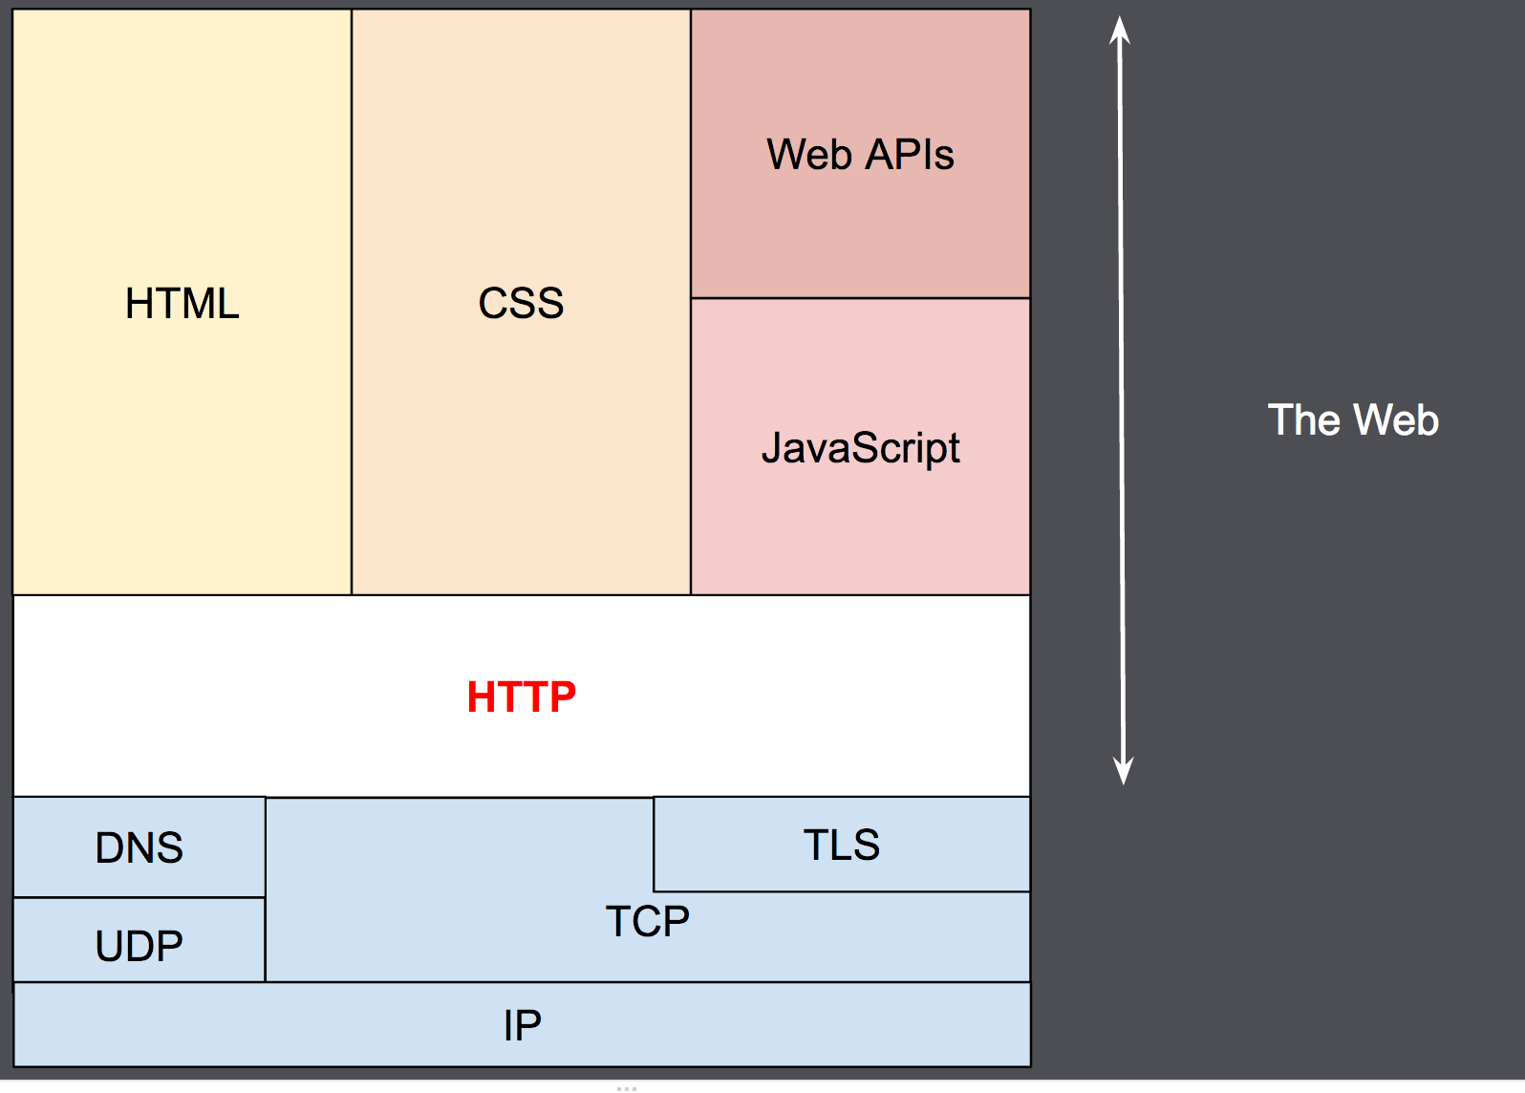
HTTP in Network

Slide 15
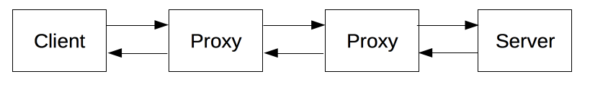
Components of HTTP-based systems
Proxy
Between the client and the server there are numerous entities, collectively called proxies, which perform different operations and act as gateways or caches
Proxies may perform numerous functions:
caching
filtering (like an antivirus scan or parental controls)
load balancing (to allow multiple servers to serve the different requests)
authentication (to control access to different resources)
logging (allowing the storage of historical information)

Slide 16
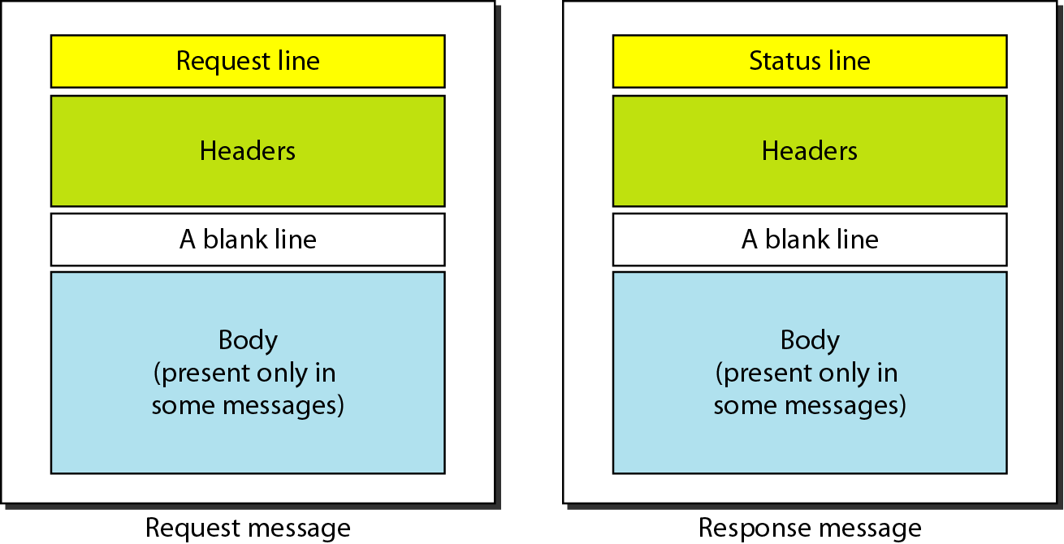
HTTP Messages

Slide 17
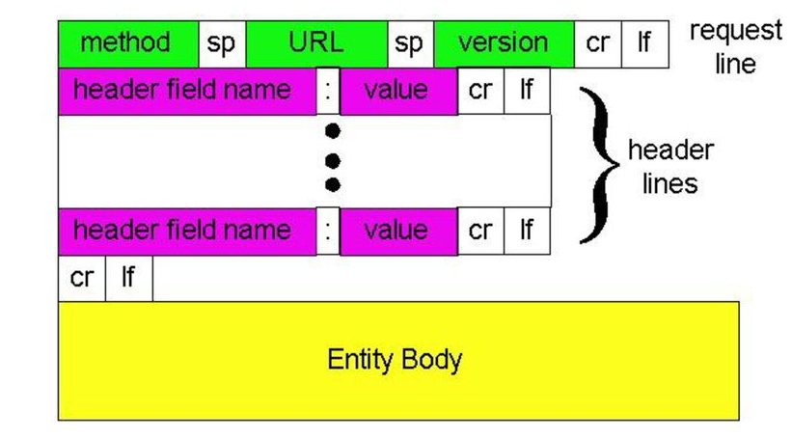
HTTP Request Messages

Slide 18
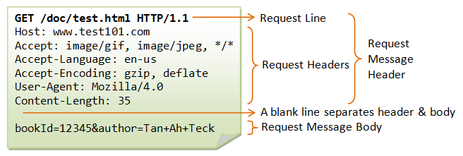
HTTP Request Messages

Slide 19
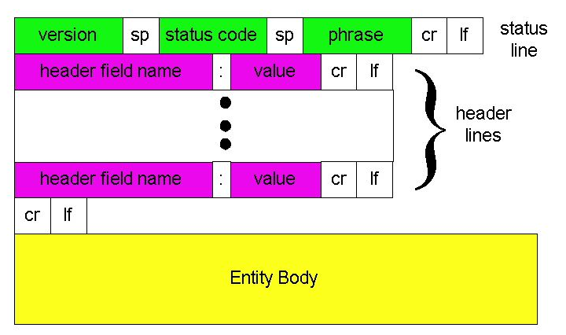
HTTP Response Messages

Slide 20
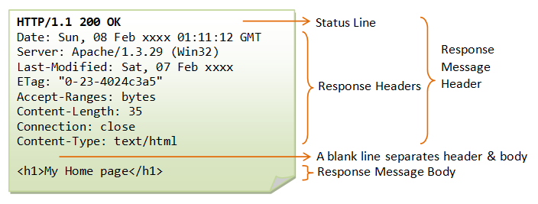
HTTP Response Message

Slide 21
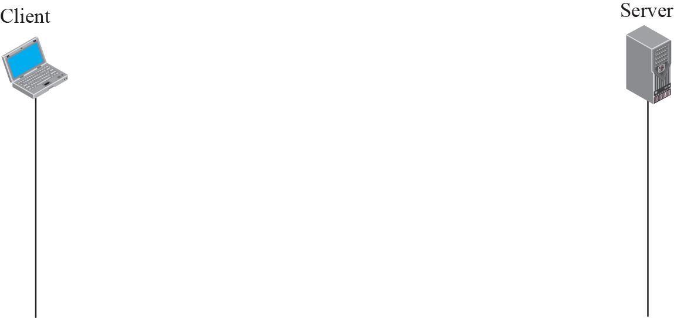
HTTP transaction

Slide 22
Web Clients
The Web client is a client-side component
Client-side components are typically computer applications running on a user's computer and connect to a server
A web client consists of two parts:
Dynamic web pages containing various types of markup language (HTML, XML, and so on), which are generated by web components running in the web tier
A web browser, which renders the pages received from the server
A web client is sometimes called a thin client

Slide 23
Web Servers
A web server is server software, or hardware dedicated to run the server software that can satisfy web client requests
A web server can contain one or more websites
Stores, processes and delivers web pages to the clients
The communication between client and server takes place using the Hypertext Transfer Protocol (HTTP)

Slide 24
Web hosting
Purchase Domain and IP
Filezilla or smartFTP… → httpdocs
index.html / index.jsp / index.php
http://www.ramsoft.com/cse/about.html
Apache tomcat - Freeware
IIS

Slide 25
SESSION 3

Slide 26
HTML5
Tables
Lists
Image
HTML5 control elements
Semantic elements
Drag and Drop
Audio
Video controls

Slide 27
HTML
Standard Markup Language for documents designed to be displayed in a web browser
Assisted by technologies such as Cascading Style Sheets (CSS) and scripting languages such as JavaScript
Describes the structure of a web page semantically
HTML Elements or Tags are the building blocks of HTML pages
Provides a means to create structured documents
HTML can embed programs written in a scripting language such as JavaScript

Slide 28
Web Page
HTML
Defines the meaning and structure of web content
CSS
Describes a web page's appearance/presentation
Javascript
Describes a web page's functionality/behavior

Slide 29
History of HTML
HTML 4.02
XHTML
HTML5
HTML 3.2
HTML 2.0
1995
1997
1999
2000
2012

Slide 30
Basic HTML Tags
Opening Tag | Closing Tag | Description
<html> | </html> | beginning and end of an HTML file
<head> | </head> | Includes information including title, meta tags, content type, links to external pages like CSS and JavaScript
<title> | </title> | This is the text that goes in the title bar or the browser window
<body> | </body> | This contains the contents of the document
<p> | </p> | This tag allows you to create paragraphs
<h1> | </h1> | This is the largest heading
<h2> | </h2> | This is second biggest heading
<h3> | </h3> | This is the next heading
<h4> | </h4> | This is another heading
<h5> | </h5> | This is the second smallest heading
<h6> | </h6> | This is the smallest heading
<hr > | n/a | This is a horizontal line. You can use width and size attributes
<b> | </b> | This makes text bold
<i> | </i> | This makes text italic
<br /> | n/a | This tag allows you to insert line breaks

Slide 31
HTML elements(Tags)
Tag Name | Purpose
<table>,<tr>,<td><th> | to create a table in html document
<u> | to set the content underline
<a> | to link one page to another page
<ol>, <ul>, <li> | to list the content(ordered / unordered)
<img> | to add image element in html document
<link> | to link the content from external source
<meta> | to specify the page description. For example: last modifier, authors, … etc.
<form>,<input>, <select>,<option> | to create html form

Slide 32
What is HTML5?
HTML5 is the newest version of HTML, only recently gaining partial support by the makers of web browsers.
It incorporates all features from earlier versions of HTML, including the stricter XHTML.
It adds a diverse set of new tools for the web developer to use.
It is still a work in progress. No browsers have full HTML5 support

Slide 33
Goals of HTML5
Support all existing web pages. With HTML5, there is no requirement to go back and revise older websites.
Reduce the need for external plugins and scripts to show website content.
Improve the semantic definition (i.e. meaning and purpose) of page elements.
Make the rendering of web content universal and independent of the device being used.
Handle web documents errors in a better and more consistent fashion.

Slide 34
Structure of HTML5
<!DOCTYPE html>
<html>
<head>
<meta charset="UTF-8">
<title>Title of the document</title>
</head>
<body>
//content of the document
</body>
</html>

Slide 35
Basic HTML5 Web Page
<!DOCTYPE html>
<html lang="en">
<head>
<meta charset="utf-8">
<title>My First HTML5 Page</title>
<link rel="stylesheet" href="style.css">
</head>
<body>
<p>HTML5 is fun!</p>
</body>
</html>

Slide 36
Other New Features in HTML5
Built-in audio and video support (without plugins)
Enhanced form controls and attributes
The Canvas (a way to draw directly on a web page)
Drag and Drop functionality
Support for CSS3 (the newer and more powerful version of CSS)
More advanced features for web developers, such as data storage and offline applications.

Slide 37
Tables
<table>
<td>
<tr>
<th>
<caption>
<tbody>
<thead>
<tfoot>

Slide 38
Tables
<!DOCTYPE html>
<html>
<head>
<title>Table Example</title>
</head>
<body>
<table border="1">
<caption>Name List</caption>
<tr>
<td>101</td>
<td>Raja</td>
</tr>
<tr>
<td>102</td>
<td>Madhan</td>
</tr>
<tr>
<td>103</td>
<td>Muthu</td>
</tr>
<tr>
<td>104</td>
<td>Naveen</td>
</tr>
</table>
</body>
</html>
Output
Name List
101 | Raja
102 | Madhan
103 | Muthu
104 | Naveen

Slide 39
Tables - Example
<table border=“1”>
<thead>
<tr>
<th>Name</th>
<th>Instrument</th>
</tr>
</thead>
<tfoot>
<tr>
<th>Name</th>
<th>Instrument</th>
</tr>
</tfoot>
<tbody>
<tr>
<td>John Lennon</td>
<td>Rhythm Guitar</td>
</tr>
<tr>
<td>Paul McCartney</td>
<td>Bass</td>
</tr>
<tr>
<td>George Harrison</td>
<td>Lead Guitar</td>
</tr>
</tbody>
</table>
Output:
Name | Instrument
John Lennon | Rhythm Guitar
Paul McCartney | Bass
George Harrison | Lead Guitar
Name | Instrument

Slide 40
SESSION 4

Slide 41
Lists
<dl> - define List
<dt> - Define Terms
<dd> - Definition
<ol> - Ordered List
<li> - List Item
Attribute: type=“1”
<ul> - Unordered List
<li> - List Item
Attribute: style="list-style-type:disc"

Slide 42
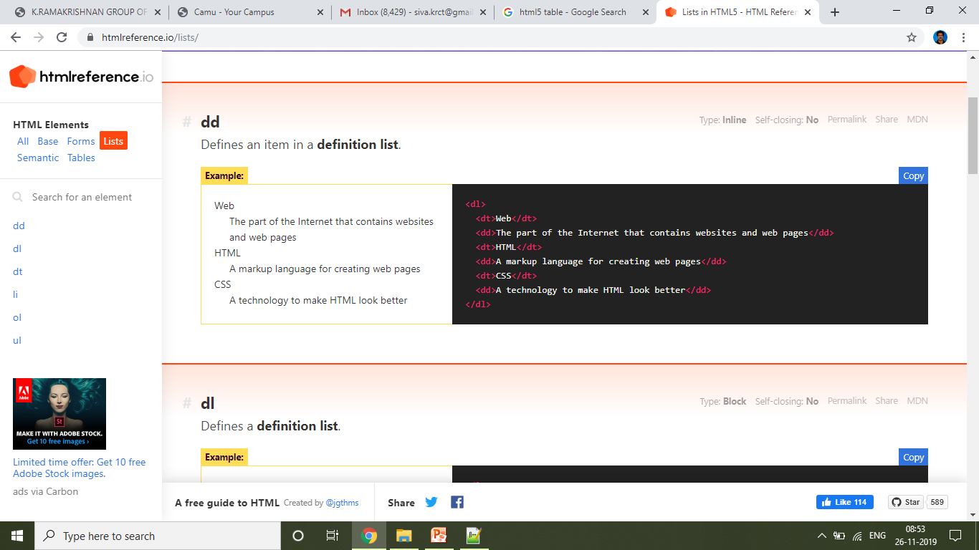
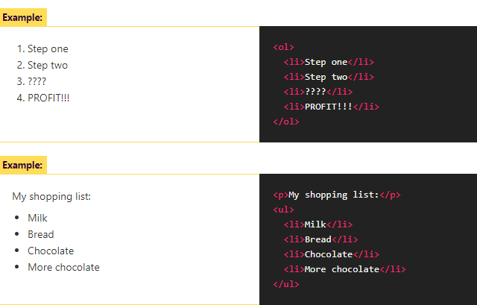
Lists Example

Slide 43
Image
<img src="/images/sunset-360.jpg"
alt="Picture of a Ha Long Bay sunset"
srcset="/images/sunset-360.jpg 360w,
/images/sunset-720.jpg 720w,
/images/sunset-1440.jpg 1440w>"
sizes="(min-width: 800px) 720px, 360px“ height=“240” width=“120”>

Slide 44
SESSION 5

Slide 45
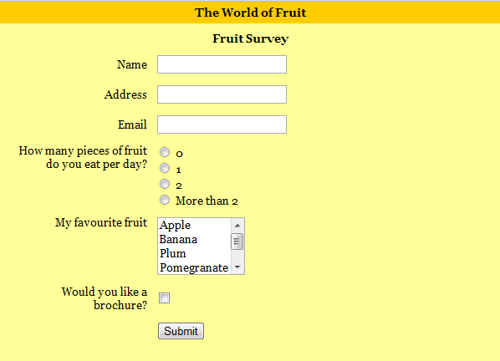
Forms in HTML5

Slide 46
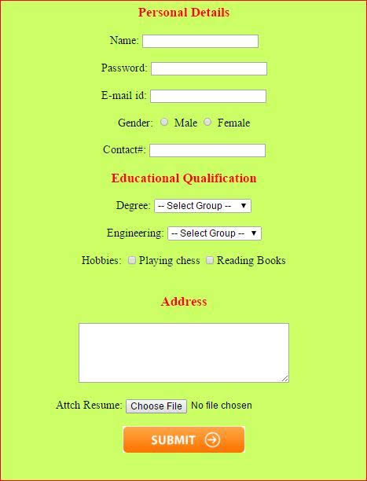

Slide 47
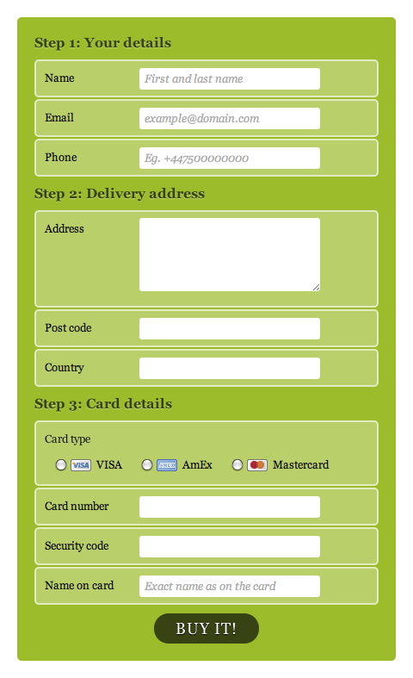

Slide 48
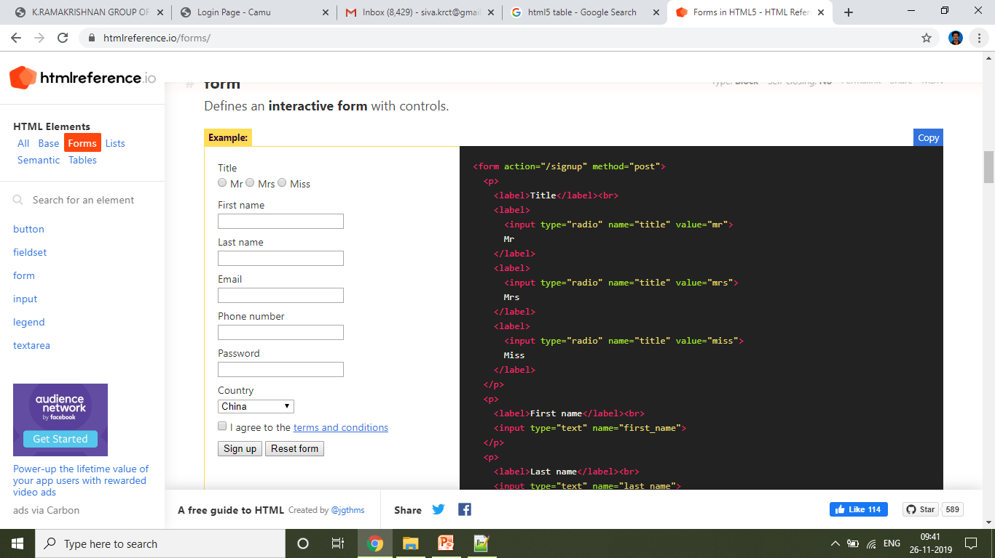
Forms in HTML5
Defines an interactive form with controls.
<form>
<p></p>
<label></label>
<input>
<select>
<option>
</select>
<button></button>
</form>

Slide 49
Forms in HTML5
<form name=“ ” action=“ ” onsubmit=“ ” method=“ ” autocomplete=“ ”>
</form>
action - Defines which URL the form's information is sent to when submitted.
action=“/contact”
action ="https://htmlreference.io/contact.jsp"
method - Defines the HTTP method used when submitting the form.
method= “get”
method=“post”
name - The form's name when sent to the server. Useful when multiple forms are present on the same web page.
name=“signupform”
autocomplete - Determines if the browser can autocomplete all the form's controls.
autocomplete=“off”
autocomplete=“on”

Slide 50
Form Elements
<input>
<select>
<textarea>
<button>
<datalist>
<output>

Slide 51
Input Types
<input type="button">
<input type="checkbox">
<input type="color">
<input type="date">
<input type="email">
<input type="file">
<input type="hidden">
<input type="image">
<input type="month">
<input type="number">
<input type="password">
<input type="radio">
<input type="range">
<input type="reset">
<input type="search">
<input type="submit">
<input type="tel">
<input type="text">
<input type="time“>

Slide 52
Form Control Elements
Search field
<input type="search" id="search" name="search">
Phone nmber field
<input type="tel" id="tel" name="tel">
URL field
<input type="url" id="url" name="url">
Numeric field
<input type="number" name="age" id="age" min="1" max="10" step="2">
Slider controls
<label for="price">Choose a maximum house price: </label>
<input type="range" name="price" id="price" min="50000" max="500000" step="100" value="250000">
<output class="price-output" for="price"></output>

Slide 53
Form Control Elements
Color picker control
<input type="color" name="color" id="color">
Date and time pickers
<input type="datetime-local" name="datetime" id="datetime">
<input type="month" name="month" id="month">
<input type="time" name="time" id="time">
<input type="week" name="week" id="week">

Slide 54
Forms in HTML5
<form name=“” action="" method="post">
<p>
<label>Title</label><br>
<label>
<input type="radio" name="title" value="mr">
Mr
</label>
<label>
<input type="radio" name="title" value="mrs">
Mrs
</label>
<label>
<input type="radio" name="title" value="miss">
Miss
</label>
</p>
<p>
<label>First name</label><br>
<input type="text" name="first_name">
</p>
<p>
<label>Last name</label><br>
<input type="text" name="last_name">
</p>
<p>
<label>Email</label><br>
<input type="email" name="email" required>
</p>
<p>
<label>Phone number</label><br>
<input type="tel" name="phone">
</p>
<p>
<label>Password</label><br>
<input type="password" name="password">
</p>
<p>
<label>Country</label><br>
<select>
<option>China</option>
<option>India</option>
<option>United States</option>
<option>Indonesia</option>
<option>Brazil</option>
</select>
</p>
<p>
<label>
<input type="checkbox" value="terms">
I agree to the <a href="/terms">terms and conditions</a>
</label>
</p>
<p>
<button>Sign up</button>
<button type="reset">Reset form</button>
</p>
</form>

Slide 55
HTML5 Form Attributes
placeholder
autocomplete
required
Example:
<input type="text" name="empname" placeholder="Enter your name" required>

Slide 56
Semantic elements
<article>
<aside>
<figcaption>
<figure>
<footer>
<header>
<main>
<mark>
<nav>
<section>
<time>

Slide 57
HTML5 Semantic elements
Tag Name | Purpose
<article> | Defines an article
<aside> | Defines content aside from the page content
<details> | Defines additional details that the user can view or hide
<figcaption> | Defines a caption for a <figure> element
<figure> | Specifies self-contained content, like illustrations, diagrams, photos, code listings, etc.
<footer> | Defines a footer for a document or section
<header> | Specifies a header for a document or section
<main> | Specifies the main content of a document
<mark> | Defines marked/highlighted text
<nav> | Defines navigation links
<section> | Defines a section in a document
<summary> | Defines a visible heading for a <details> element
<time> | Defines a date/time

Slide 58
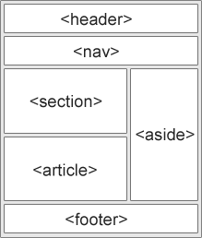
Structure of Simple HTML5 Document

Slide 59
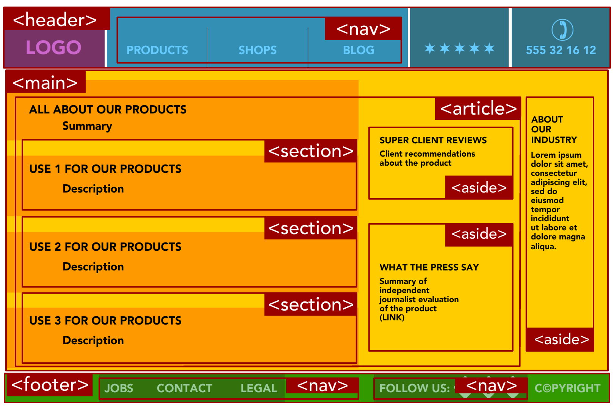

Slide 60
SESSION 6

Slide 61
Drag and Drop
HTML Drag and Drop interfaces enable applications to use drag-and-drop features in browsers
The user may select draggable elements with a mouse, drag those elements to a droppable element, and drop them by releasing the mouse button

Slide 62
Events for Drag and Drop feature
Event | Description
drag | It fires every time when the mouse is moved while the object is being dragged.
dragstart | Calls a function, drag(event), that specifies what data to be dragged
dragenter | To determine whether or not the drop target is to accept the drop. If the drop is to be accepted, then this event has to be canceled
dragover | Specifies where the dragged data can be dropped
dragleave | Occurs when the mouse leaves an element before a valid drop target while the drag is ocurring
drop | Specifies where the drop was occurred at the end of the drag operation
dragend | Occurs when the user has finished dragging an element

Slide 63
Procedure for Drag and Drop
Step 1: Make an object draggable
First set the draggable attribute to true for that element to be draggable <img draggable = “true”>
Then, specify what should happen when the element is dragged. The ondragstart attribute calls a function, drag(event), that specifies what data to be dragged. The dataTransfer.setData() method sets the data type and the value of the dragged data
The event listener ondragstart will set the allowed effects (copy, move, link, or some combination).
function dragStart(ev)
{
ev.dataTransfer.setData("text", ev.target.id);
}

Slide 64
Procedure for Drag and Drop
Step 2: Dropping the Object
The ondragover event specifies where the dragged data can be dropped. By default, data/elements cannot be dropped in other elements. To allow a drop, it must prevent the default handling of the element. This is done by calling the event.preventDefault() method
Finally, the drop event, which allows the actual drop to be performed
function dragDrop(ev)
{
ev.preventDefault();
var data = ev.dataTransfer.getData("text");
ev.target.appendChild(document.getElementById(data));
}

Slide 65
Drag and Drop Example
<script>
function allowDrop(ev)
{
ev.preventDefault();
}
function drag(ev)
{
ev.dataTransfer.setData("text", ev.target.id);
}
function drop(ev)
{
ev.preventDefault();
var data = ev.dataTransfer.getData("text");
ev.target.appendChild(document.getElementById(data));
}
</script>
</head>
<!DOCTYPE HTML>
<html>
<head>
<style>
#div1 {
width: 350px;
height: 100px;
padding: 10px;
border: 1px solid #aaaaaa;
}
</style>
<body>
<p>Drag the image into the rectangle:</p>
<div id="div1" ondrop="drop(event)" ondragover="allowDrop(event)"></div>
<br>
<img id="drag1" src="dragdrop.jpg" draggable="true" ondragstart="drag(event)"
width="350" height="100">
</body>
</html>

Slide 66
Audio
<audio controls> <source src="horse.ogg" type="audio/ogg"> <source src="horse.mp3" type="audio/mpeg"> Your browser does not support the audio element. </audio>
Controls - adds audio controls, like play, pause, and volume
<source> - allows you to specify alternative audio files which the browser may choose from. The browser will use the first recognized format
The text between the <audio> and </audio> tags will only be displayed in browsers that do not support the <audio> element

Slide 67
Video controls
<video width="320" height="240" controls> <source src="movie.mp4" type="video/mp4"> <source src="movie.ogg" type="video/ogg"> </video>
controls - adds video controls, like play, pause, and volume
If height and width are not set, the page might flicker while the video loads
<source> - allows you to specify alternative video files which the browser may choose from
The text between the <video> and </video> tags will only be displayed in browsers that do not support the <video> element

Slide 68
SESSION 7

Slide 69
CSS3
Inline, embedded and external style sheets
Rule cascading
Inheritance
Backgrounds
Border Images
Colors
Shadows
Text - Transformations – Transitions
Animations

Slide 70
CSS3 - Introduction
CSS stands for Cascading Style Sheets
CSS is a standard style sheet language used for describing the presentation of the web pages.
CSS was designed to enable the separation of presentation and content
CSS3 is the latest version of the CSS specification

Slide 71
Uses of CSS
To apply same style rules on multiple elements.
To control the presentation of multiple pages of a website with a single style sheet
To present the same page differently on different devices
To style dynamic states of elements such as hover, focus, etc. that isn't possible otherwise.
To change the position of an element on a web page without changing the markup.
To alter the display of existing HTML elements.
To transform elements like scale, rotate, skew, etc. in 2D or 3D space.
To create animations and transitions effects without using any JavaScript.
To create print friendly version of your web pages.

Slide 72
Advantages of Using CSS
CSS Save Lots of Time
Easy Maintenance
Pages Load Faster
Superior Styles to HTML
Multiple Device Compatibility

Slide 73
Including CSS in HTML Documents or CSS Types
You can include CSS in an HTML document in three ways:
Inline styles — Using the style attribute in the HTML start tag.
Embedded styles — Using the <style> element in the head section of a document.
External style sheets — Using the <link> element, pointing to an external CSS file.

Slide 74
Inline Styles
Inline styles are used to apply the unique style rules to an element by putting the CSS rules directly into the start tag.
It can be attached to an element using the style attribute
The style attribute includes a series of CSS property and value pairs.
Each "property: value" pair is separated by a semicolon (;)
Example:
<h1 style="color:red; font-size:30px;">This is a heading</h1>
<p style="color:green; font-size:22px;">This is a paragraph.</p>

Slide 75
Embedded (or) Internal Style Sheets
Embedded or internal style sheets only affect the document they are embedded in.
Embedded style sheets are defined in the <head> section of an HTML document using the <style> element
You can define any number of <style> elements in a HTML document but they must appear between the <head> and </head> tags

Slide 76
Embedded Style Sheets
<!DOCTYPE html>
<html>
<head>
<title>Embedded Style Sheet</title>
<style>
body
{
background-color: YellowGreen;
}
p
{
color: #fff;
}
</style>
</head>
<body>
<h1>This is a heading</h1>
<p>This is a paragraph of text.</p>
</body>
</html>

Slide 77
External Style Sheets
An external style sheet is ideal when the style is applied to many pages of the website.
An external style sheet holds all the style rules in a separate document that you can link from any HTML file on your site
External style sheets are the most flexible because with an external style sheet, you can change the look of an entire website by changing just one file

Slide 78
External Style Sheets
style1.css
body
{
background: lightyellow;
font: 18px Arial, sans-serif;
}
h1
{
color: orange;
}
extcss.html
<!DOCTYPE html>
<html>
<head>
<title>My HTML Document</title>
<link rel="stylesheet" href="style1.css">
</head>
<body>
<h1>This is a heading</h1>
<p>This is a paragraph of text.</p>
</body>
</html>

Slide 79
Importing External Style Sheets
The @import rule is another way of loading an external style sheet
The @import statement instructs the browser to load an external style sheet and use its styles.
You can use it in two ways:
1. Within header
<style>
@import url("css/style.css");
p {
color: blue;
font-size: 16px;
}
</style>
2. within another style sheet
@import url("css/layout.css");
@import url("css/color.css");
body {
color: blue;
font-size: 14px;
}

Slide 80
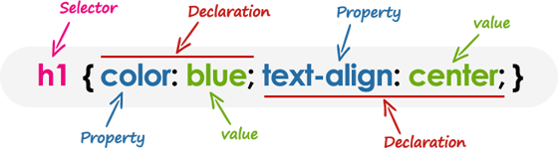
CSS Syntax
CSS rules have two main parts, a selector and one or more declarations:
Selectors are used to declare which of the markup elements a style applies to
The declarations that appear in the block that follows the selector may be applied to all elements of a specific type, or only those elements that match a certain attribute
Each declaration consists of a property and a value

Slide 81
Example
/* This is a CSS comment */
h1
{
color: blue;
text-align: center;
}

Slide 82
CSS Text Properties
Property | Description | Values
color | Sets the color of text | Red,blue
direction | Specifies the text direction/writing direction | rtl, ltr
letter-spacing | Increases or decreases the space between characters in a text | 3px,5px
line-height | Sets the line height | 10px
text-align | Specifies the horizontal alignment of text | left,right,center,jusify
text-decoration | Specifies the decoration added to text | none, underline, overline, line-through
text-indent | Specifies the indentation of the first line in a text-block | 50px
text-shadow | Specifies the shadow effect added to text | 2px 2px red
text-transform | Controls the capitalization of text | uppercase, lowercase, capitalize
text-overflow | Specifies how overflowed content that is not displayed should be signaled to the user | clip, ellipsis
vertical-align | Sets the vertical alignment of an element | Baseline, text-top, text-bottom,sub,super
white-space | Specifies how white-space inside an element is handled
word-spacing | Increases or decreases the space between words in a text

Slide 83
CSS Units
Unit | Description
cm | centimeters
mm | millimeters
in | inches (1in = 96px = 2.54cm)
px * | pixels (1px = 1/96th of 1in)
pt | points (1pt = 1/72 of 1in)
pc | picas (1pc = 12 pt)
em | Relative to the font-size of the element (2em means 2 times the size of the current font)
* Pixels (px) are relative to the viewing device

Slide 84
CSS Selectors
Selectors are one of the most important aspects of CSS as they are used to select elements on a web page so that they can be styled.
You can define selectors in various ways.
Element Type Selector
Id Selectors
Class Selectors
Descendant Selectors
Grouping Selectors

Slide 85
Element Type Selector - Id Selectors - Class Selectors
<!DOCTYPE html>
<html lang="en">
<head>
<meta charset="utf-8">
<title>Example of CSS selector</title>
<style>
h1 {
color: Yellow;
}
p {
color: green;
}
#error {
color: #ff0000;
}
.blue {
color: #0000ff;
}
</style>
</head>
<body>
<h1>This is heading</h1>
<p>This is a paragraph.</p>
<p id=“error">This is a id selector</p>
<p class="blue">This is a class selector</p>
</body>
</html>

Slide 86
Descendant Selectors and Grouping Selector
<!DOCTYPE html>
<html>
<head>
<meta charset="utf-8">
<title>Descendant Selectors</title>
<style>
h1 em { color: green; }
ul.menu
{
padding: 0;
list-style: none;
}
ul.menu li{
display: inline;
}
ul.menu li a {
margin: 10px;
text-decoration: none;
}
</style>
</head>
<body>
<h1>This is a <em>heading</em></h1>
<ul class="menu">
<li><a href="#">Home</a></li>
<li><a href="#">About</a></li>
<li><a href="#">Services</a></li>
<li><a href="#">Contact</a></li>
</ul>
</body>
</html>

Slide 87
SESSION 8

Slide 88
Rule cascading
The cascading rules define which elements take precedence over others.
Sort by Importance
Sort by weight
Sort by Specificity
Sort by Order

Slide 89
Rules of Cascading
Sort by Importance
an ID will win out over a class
a class will win out over a tag
Sort by weight
Author: Style Sheet - Inline within the body of the web page
Author: Style Sheet - Embedded in the head of the web page
Author: Style Sheet – Linked
User: Style Sheet
Default: Browser

Slide 90
Rules of Cascading
Sort by Specificity
#content p em{ color: #foo;}
#content p{color: #f00;}
#content{color: #333;}
Sort by Order
If two rules have the same properties, specificy and values the one that appears later in the css will be the one that the browser uses

Slide 91
Inheritance
Some CSS properties by default inherit values set on the current element's parent element
For example, if you set a color and font-family on an element, every element inside it will also be styled with that color and font, unless you've applied different color and font values directly to them.

Slide 92
Inheritance Example
<!DOCTYPE html>
<html>
<head>
<style>
body
{
color: blue;
font-family: Arial;
}
h1
{
color: Yellow;
}
p
{
text-align:justify;
font-size:20px;
}
b
{
color:red;
}
</style>
</head>
<body>
<h1>Inheritance Example</h1>
<p>Some CSS properties by default <b>inherit</b> values set on the current element's parent element. For example, if you set a color and font-family on an element, every element inside it will also be styled with that color and font, unless you've applied different color and font values directly to them. </p>
</body>
</html>

Slide 93
Backgrounds
CSS background properties:
background-color
background-image
background-repeat
background-attachment
background-position
CSS3 background properties
background-size
background-clip
background-origin

Slide 94
Backgrounds
Property Name | Value
background-color | red, blue
background-image | url("gradient_bg.png")
background-repeat | repeat| repeat-x | repeat-y | no-repeat
bacground-attachment | scroll | fixed
background-position | left top | left center | left bottom | right top right center | right bottom | center top | center center | center bottom
background-size | Specify the size of a background-image with "auto" and in pixels
background-clip | defines how far the background (color or image) should extend within an element
background-origin | padding-box | border-box | content-box | initial | inherit

Slide 95
Background Properties Example
<!DOCTYPE html>
<html>
<head>
<title>Background Properties</title>
<style>
p{
font-size:30px;
text-align:center;
color:yellow;
}
body
{
border: 2px solid black;
padding: 25px;
background-color:brown;
background-image: url(images/bgimg3.jpg);
background-repeat:no-repeat;
background-position:right top ;
bacground-attachment: fixed;
background-size:100px 100px;
}
</style>
</head>
<body>
<p>This is a heading</p>
</body>
</html>

Slide 96
Border Images
The border-image property allows you to specify an image to be used as the border around an element.
The property has three parts:
The image to use as the border
Where to slice the image
Define whether the middle sections should be repeated or stretched

Slide 97
Border Images
<!DOCTYPE html>
<html>
<head>
<title>Descendant Selectors</title>
<style>
#borderimg
{
border: 30px solid transparent;
padding: 25px;
border-image: url(images/border3.jpg);
border-image-repeat: round;
border-image-slice: 30;
border-image-width: 10px;
}
</style>
</head>
<body>
<p id="borderimg">This is a heading</p>
</body>
</html>

Slide 98
Colors
Different ways of representing color in html is as follows:
Color Name
Example: color:red;
Hex Code #RRGGBB
Example: color:#FF0000;
Decimal Code (R,G,B)
Example:color:rgb(255,0,0);

Slide 99
Shadows
CSS shadow properties
Property | Description
box-shadow | Adds one or more shadows to an element
text-shadow | Adds one or more shadows to a text

Slide 100
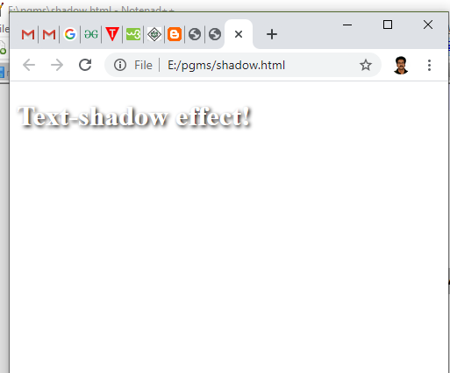
Text Shadow Example
<!DOCTYPE html>
<html>
<head>
<style>
h1
{
color: white;
text-shadow: 2px 2px 4px #000000;
}
</style>
</head>
<body>
<h1>Text-shadow effect!</h1>
</body>
</html>
OUTPUT:

Slide 101
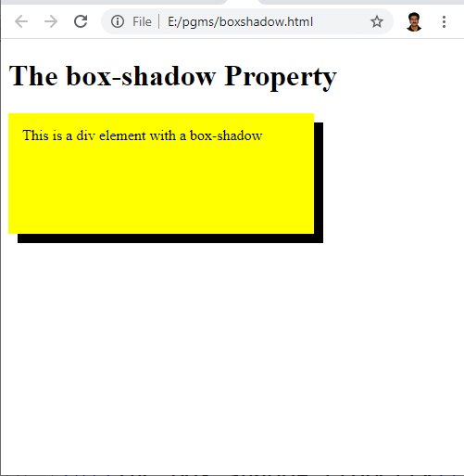
Box Shadow Example
<!DOCTYPE html>
<html>
<head>
<style>
div {
width: 300px;
height: 100px;
padding: 15px;
background-color: yellow;
box-shadow: 10px 10px;
}
</style>
</head>
<body>
<h1>The box-shadow Property</h1>
<div>This is a div element with a box-shadow</div>
</body>
</html>
OUTPUT:

Slide 102
SESSION 9

Slide 103
Text - Transformations
2D Transformation
3D Transformation

Slide 104
CSS3 2D Transforms
2D Transforms give us the ability to perform basic manipulations on elements in space
A transformation modify an element by its shape, size and position. It transforms the elements along the X-axis and Y-axis. There are several types of transformation which are listed below:
translate(), translateX(), traslateY()
rotate()
scale(), scaleX(), scaleY()
skew(), skewX(), skewY()
matrix()

Slide 105
CSS3 2D Transforms
translate(), translateX(), traslateY()
moves an element from its current position
rotate()
rotates an element clockwise or counter-clockwise according to a given degree
scale(), scaleX(), scaleY()
increases or decreases the size of an element
skew(), skewX(), skewY()
skews an element along the X and Y-axis by the given angles
matrix()
combines all the 2D transform methods into one

Slide 106
2D Transform Methods
Function | Description
translate(tx,ty) | Moves the element by the given amount along the X and Y-axis.
translateX(tx) | Moves the the element by the given amount along the X-axis.
translateY(ty) | Moves the the element by the given amount along the Y-axis.
rotate(a) | Rotates the element by the specified angle around the origin of the element, as defined by the transform-origin property.
scale(sx,sy) | Scale the width and height of the element up or down by the given amount. The function scale(1,1) has no effect.
scaleX(sx) | Scale the width of the element up or down by the given amount.
scaleY(sy) | Scale the height of the element up or down by the given amount.
skew(ax,ay) | Skews the element by the given angle along the X and Y-axis.
skewX(ax) | Skews the element by the given angle along the X-axis.
skewY(ay) | Skews the element by the given angle along the Y-axis.
matrix(n,n,n,n,n,n) | Specifies a 2D transformation in the form of a transformation matrix comprised of the six values.

Slide 107
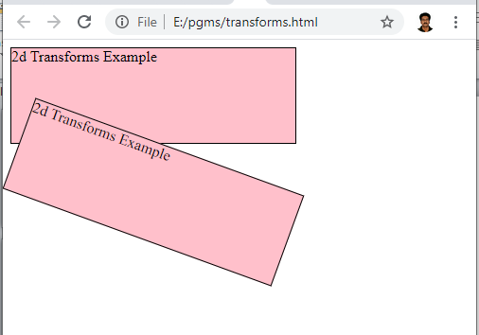
2D Transforms Example
<html>
<head>
<style>
div {
width: 300px;
height: 100px;
background-color: pink;
border: 1px solid black;
}
div#myDiv {
transform: rotate(20deg);
}
</style>
</head>
<body>
<div>
2d Transforms Example
</div>
<div id = "myDiv">
2d Transforms Example
</div>
</body>
</html>
OUTPUT:

Slide 108
3D Transform Functions
Function | Description
translate3d(tx,ty,tz) | Moves the element by the given amount along the X, Y & Z-axis.
translateX(tx) | Moves the element by the given amount along the X-axis.
translateY(ty) | Moves the element by the given amount along the Y-axis.
translateZ(tz) | Moves the element by the given amount along the Z-axis.
rotate3d(x,y,z, a) | Rotates the element in 3D space by the angle specified in the last parameter, around the [x,y,z] direction vector.
rotateX(a) | Rotates the element by the given angle around the X-axis.
rotateY(a) | Rotates the element by the given angle around the Y-axis.
rotateZ(a) | Rotates the element by the given angle around the Z-axis.
scale3d(sx,sy,sz) | Scales the element by the given amount along the X, Y and Z-axis. The function scale3d(1,1,1) has no effect.
scaleX(sx) | Scales the element along the X-axis.
scaleY(sy) | Scales the element along the Y-axis.
scaleZ(sz) | Scales the element along the Z-axis.
matrix(n,n,n,n,n,n, n,n,n,n,n,n,n,n,n,n) | Specifies a 3D transformation in the form of a 4×4 transformation matrix of 16 values.
perspective(length) | Defines a perspective view for a 3D transformed element. In general, as the value of this function increases, the element will appear further away from the viewer.

Slide 109
Text Transitions
Property | Description
transition | A shorthand property for setting all the four individual transition properties in a single declaration.
transition-delay | Specifies when the transition will start.
transition-duration | Specifies the number of seconds or milliseconds a transition animation should take to complete.
transition-property | Specifies the names of the CSS properties to which a transition effect should be applied.
transition-timing-function | Specifies how the intermediate values of the CSS properties being affected by a transition will be calculated.

Slide 110
CSS3 Animation
An animation lets an element gradually change from one style to another.
You can change as many CSS properties you want, as many times you want.
To use CSS animation, you must first specify some keyframes for the animation.
Keyframes hold what styles the element will have at certain times.

Slide 111
CSS3 Animation
@keyframe animation-name
When you specify CSS styles inside the @keyframes rule, the animation will gradually change from the current style to the new style at certain times.
animation-name
Defines the name of the animation specified in the @keyframe
animation-duration
defines how long time an animation should take to complete
If the animation-duration property is not specified, no animation will occur, because the default value is 0s

Slide 112
CSS3 Animation Example
<!DOCTYPE html>
<html>
<head>
<title>Animation Example</title>
<style>
h1,h2
{
text-align:center;
}
@keyframes example
{
from {font-size: 20px;}
to {font-size:40px;}
}
h1
{
animation-name:example;
animation-duration: 4s;
}
</style>
</head>
<body>
<h1>K.RAMAKRISHNAN COLLEGE OF TECHNOLOGY</h1>
<h2>SAMAYAPURAM, TRICHY</h2>
<hr>
</body>
</html>

Slide 113
CSS3 Animation Properties
Property | Description
animation | A shorthand property for setting all the animation properties in single declaration.
animation-name | Specifies the name of @keyframes defined animations that should be applied to the selected element.
animation-duration | Specifies how many seconds or milliseconds that an animation takes to complete one cycle of the animation.
animation-timing-function | Specifies how the animation will progress over the duration of each cycle i.e. the easing functions.
animation-delay | Specifies when the animation will start.
animation-iteration-count | Specifies the number of times an animation cycle should be played before stopping.
animation-direction | Specifies whether or not the animation should play in reverse on alternate cycles.
animation-fill-mode | Specifies how a CSS animation should apply styles to its target before and after it is executing.
animation-play-state | Specifies whether the animation is running or paused.
@keyframes | Specifies the values for the animating properties at various points during the animation.

Slide 114
<!DOCTYPE html>
<html>
<head>
<style>
div
{
width: 200px;
height: 100px;
background-color: red;
color: yellow;
position: relative;
animation-name: example;
animation-duration: 4s;
animation-delay: 2s;
}
@keyframes example
{
0% {background-color:red; left:0px; top:0px;}
25% {background-color:yellow; left:200px; top:0px;}
50% {background-color:blue; left:200px; top:200px;}
75% {background-color:green; left:0px; top:200px;}
100% {background-color:red; left:0px; top:0px;}
}
</style>
</head>
<body>
<h1>Animation Example</h1>
<div>Welcome to CSS Animation</div>
</body>
</html>

